Slide 1


PHC6791 Data Visualisation in Health Sciences
Individual Project
Exploring the Impact of Age, Smoking, and Other Factors on Stroke Incidence

Slide 2

Background
What is a stroke?
Stroke is a medical emergency. A stroke occurs when blood flow to a part of your brain is interrupted or reduced, preventing brain tissue from getting oxygen and nutrients. Brain cells begin to die within minutes
Risk factors:
Age: People aged 55 years and over
Hypertension: if the systolic pressure is 140 mm Hg or more, or the diastolic pressure is 90 mm Hg or more
Hypercholesterolemia: If the cholesterol level in the blood is 200 milligrams per deciliter
Smoking
Diabetes
Obesity: if the body mass index (BMI) is 30 or more

Slide 3
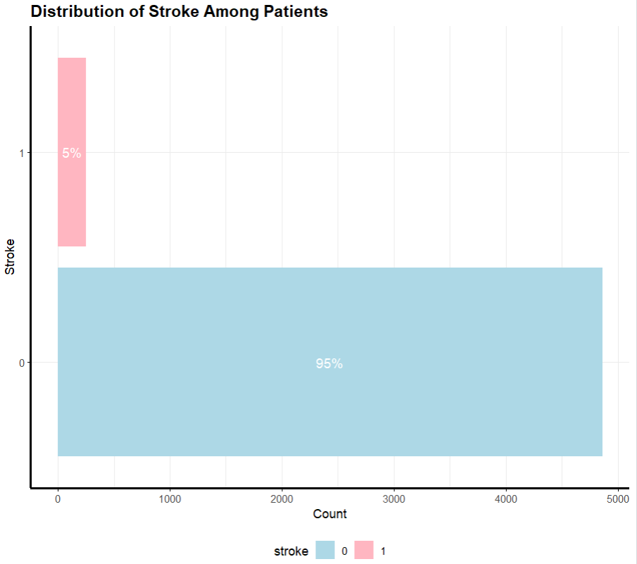

Motivation
The aim of our project is to explore the factors that contribute to stroke in individuals and investigate whether machine learning techniques can be applied to accurately detect stroke based on certain features.

Slide 4
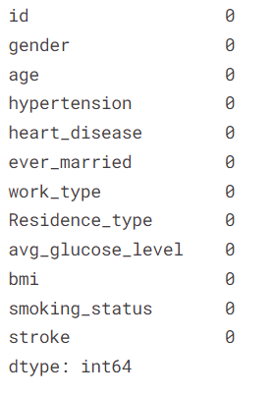
Dataset and Insights
Dataset used - The Kaggle dataset – Stroke Prediction Dataset used in our project is a collection of health records of patients that are used for predicting the likelihood of a stroke. The dataset contains various features such as age, gender, smoking status, BMI, heart disease, and other relevant medical information.
The dataset contains both categorical and numerical features.
The categorical features include gender, ever_married, work_type, residence_type, and smoking_status.
The binary numerical features are hypertension, heart_disease, and stroke.
The continuous numerical features are age, avg_glucose_level, and BMI.

Slide 5
Hypotheses
Older individuals may have a higher likelihood of experiencing a stroke.
Smoking may increase the risk of stroke.
History of heart disease is a major factor contribution to stroke risk.
Body mass index (BMI) may be associated with an increased risk of stroke.
Glucose levels may increase the risk of stroke.

Slide 6
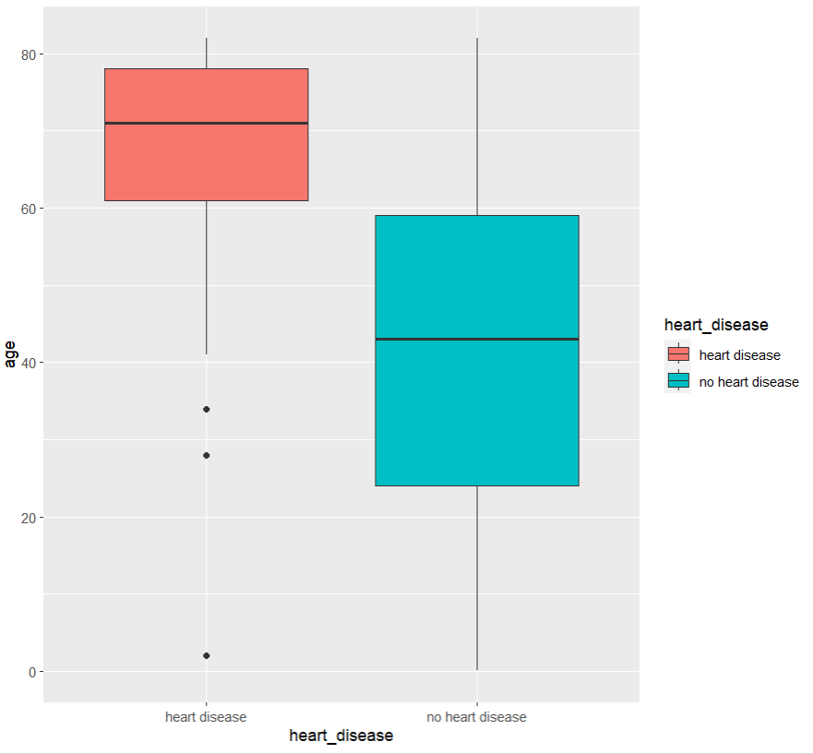
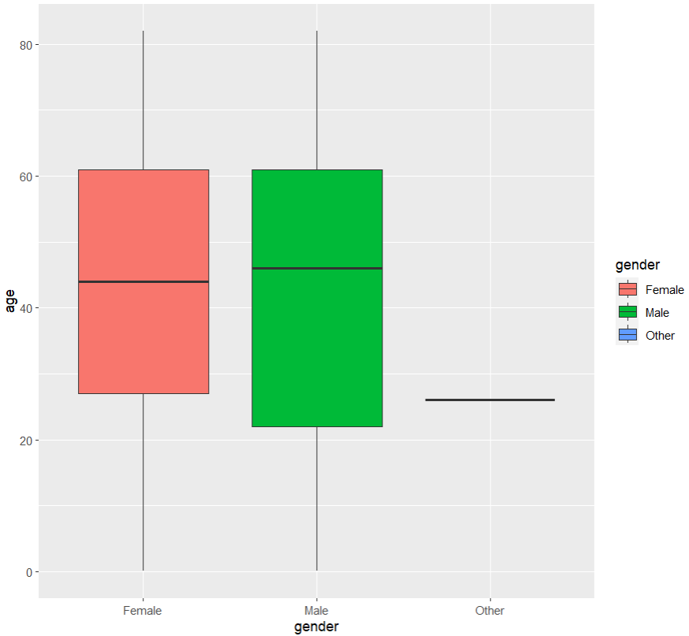
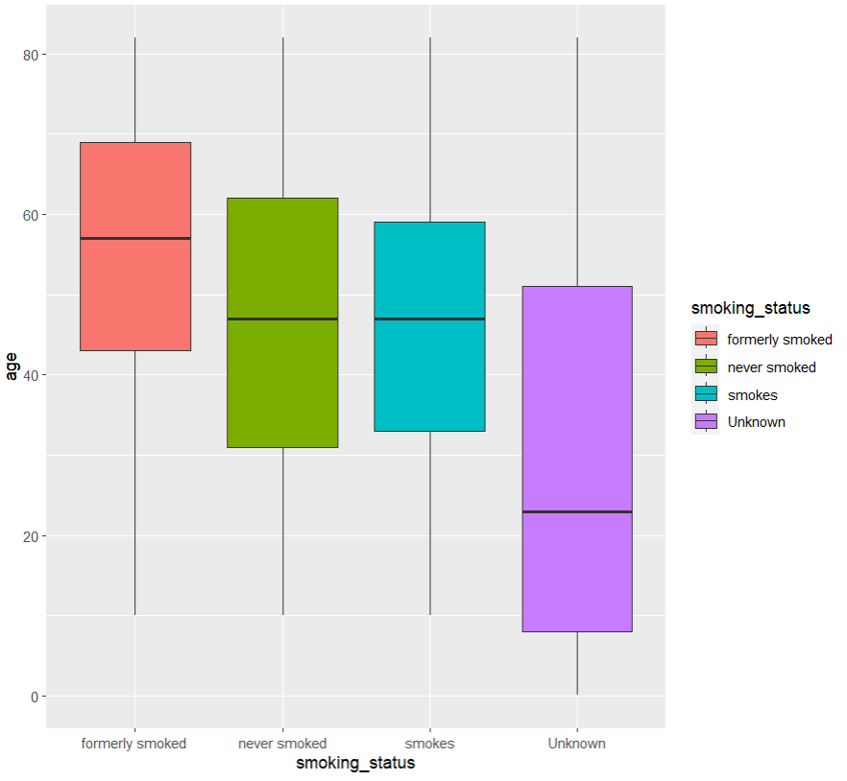
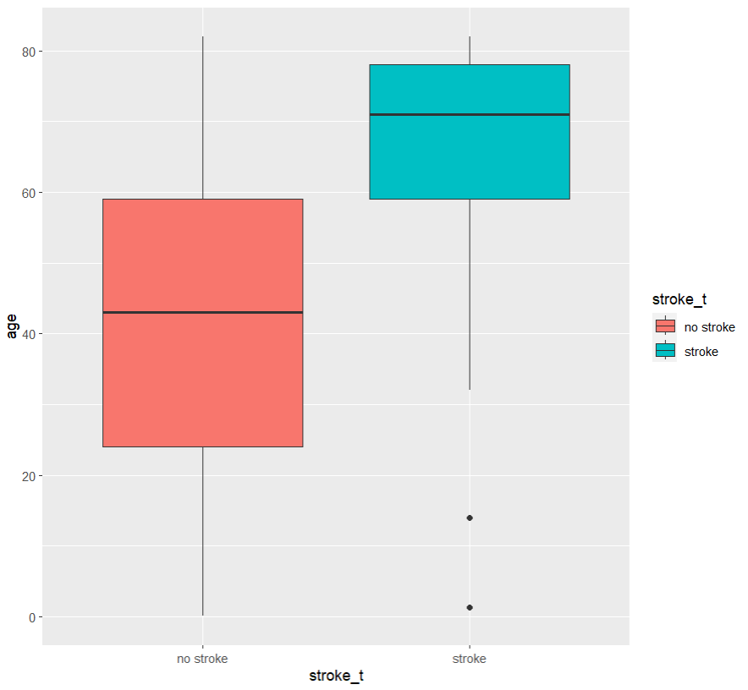
Box Plots of EDA on various factors and their relationship with age

Slide 7
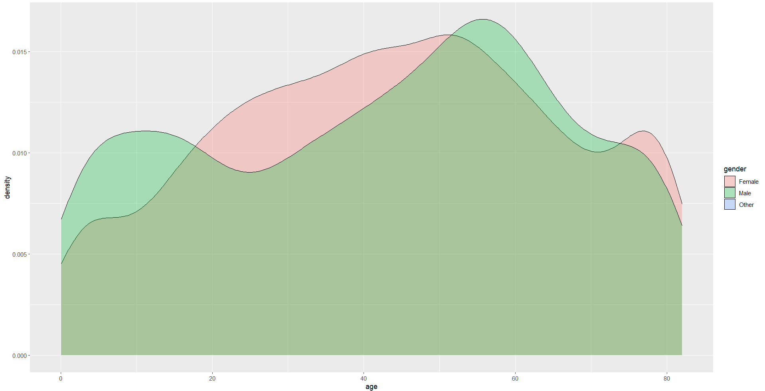
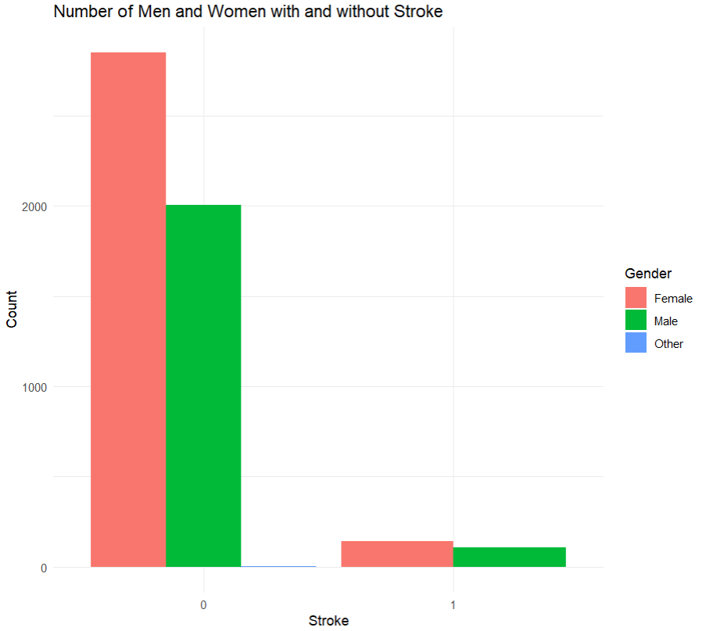
Age and Gender demographics

Slide 8
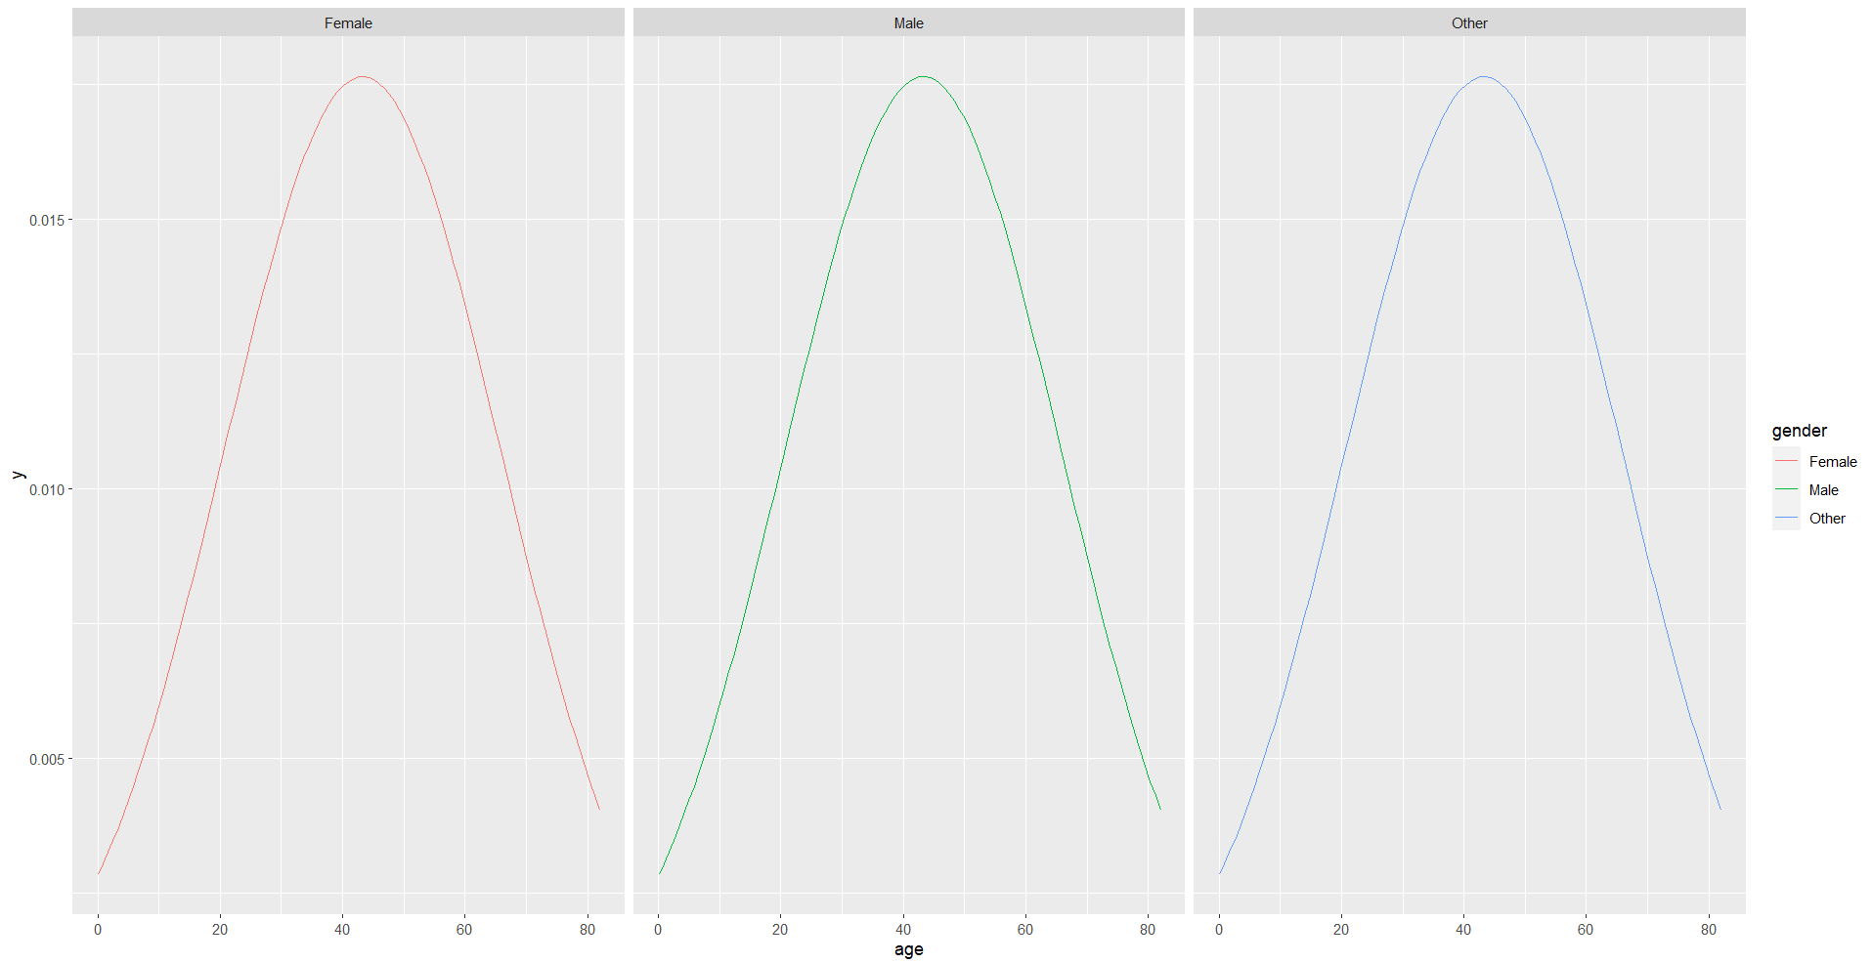
Normal distribution gender-wise

Slide 9
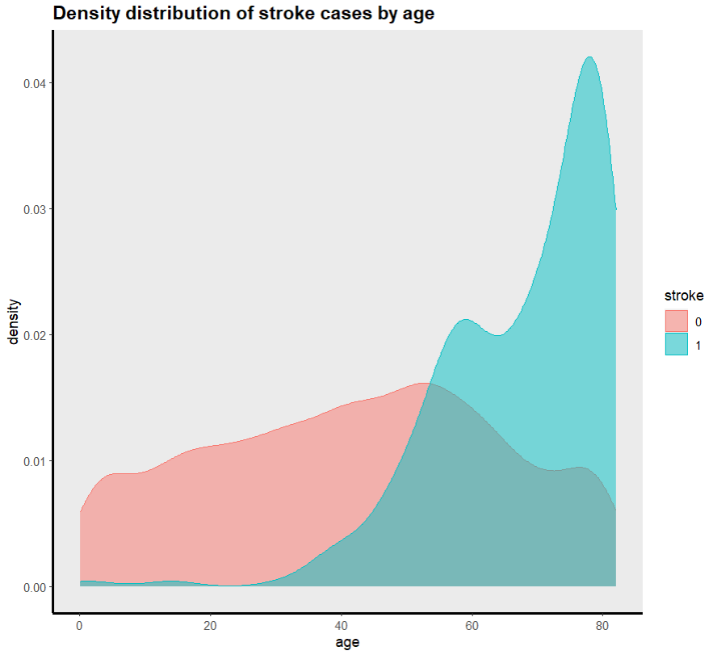
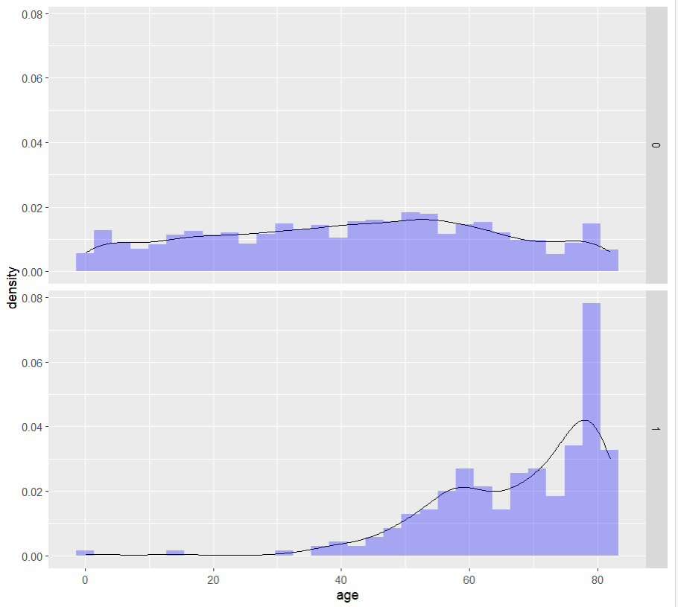
Age vs Stroke status

Slide 10
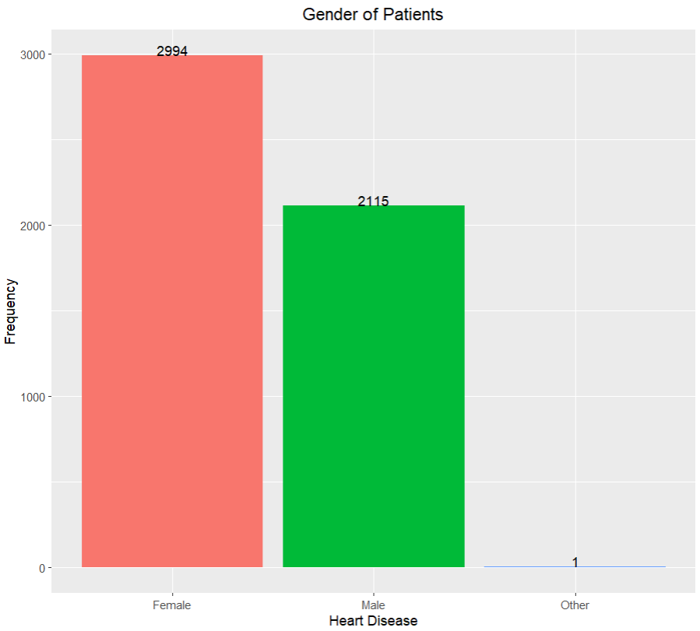
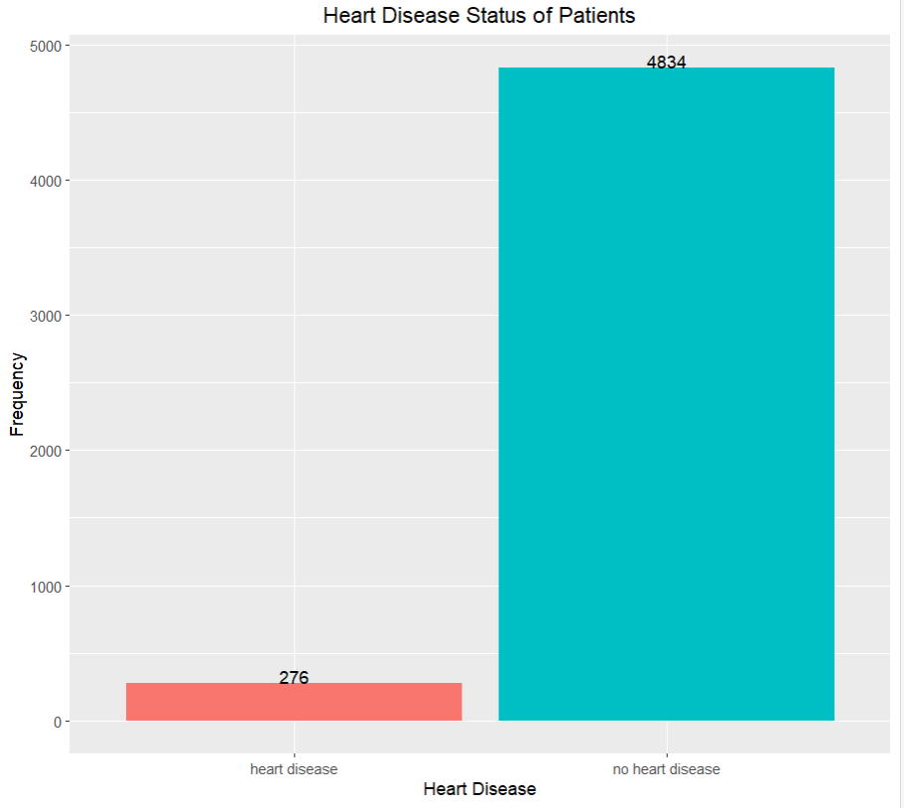
Heart disease demographic

Slide 11
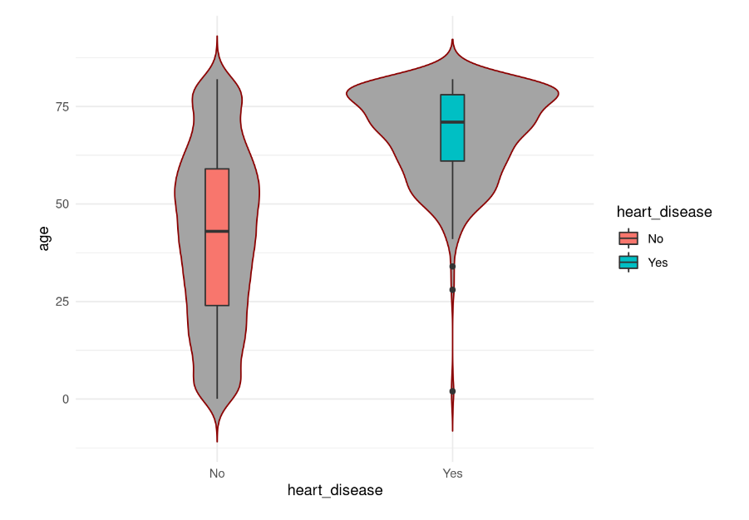
Heart disease vs stroke

Slide 12
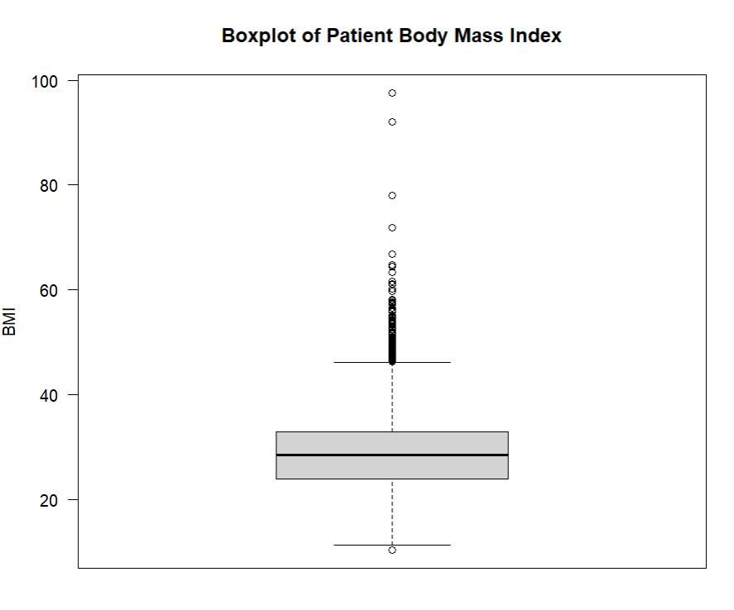
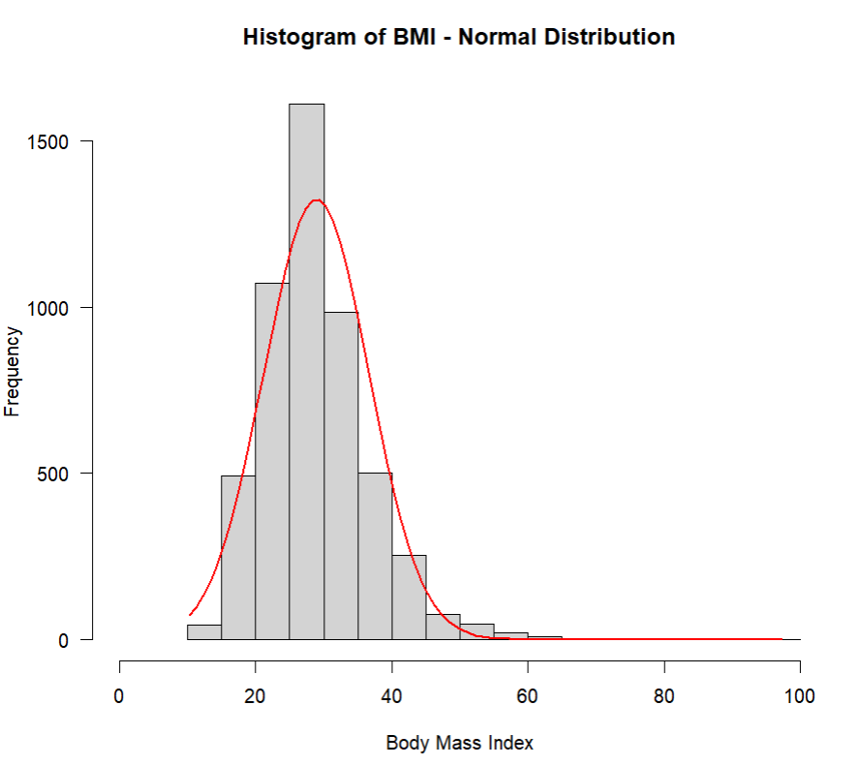
BMI distribution

Slide 13
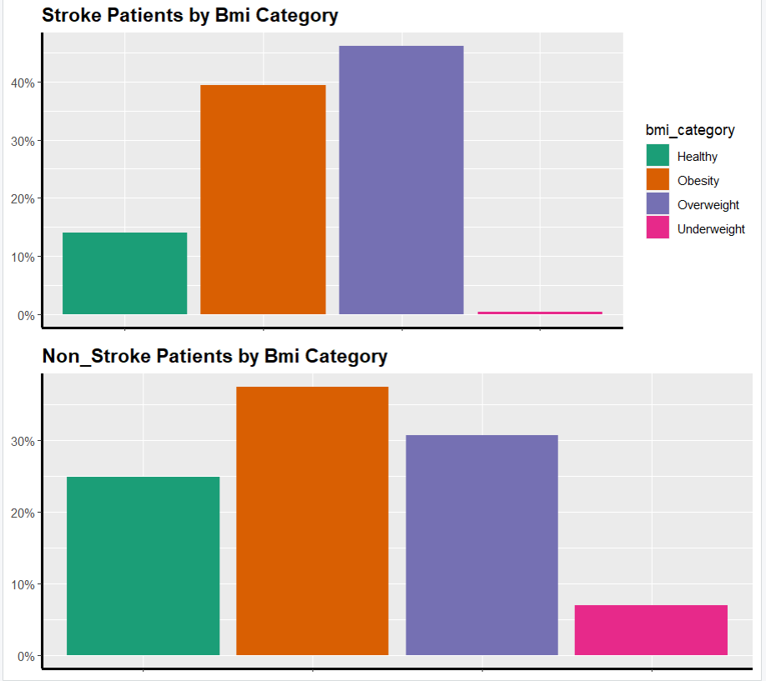
BMI – Stroke vs No Stroke

Slide 14
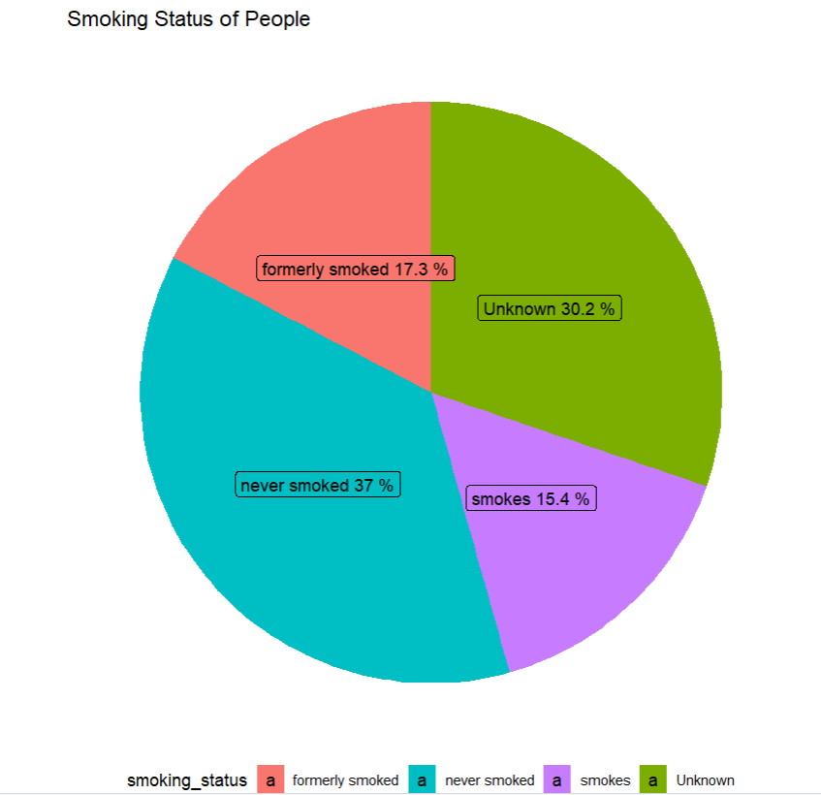
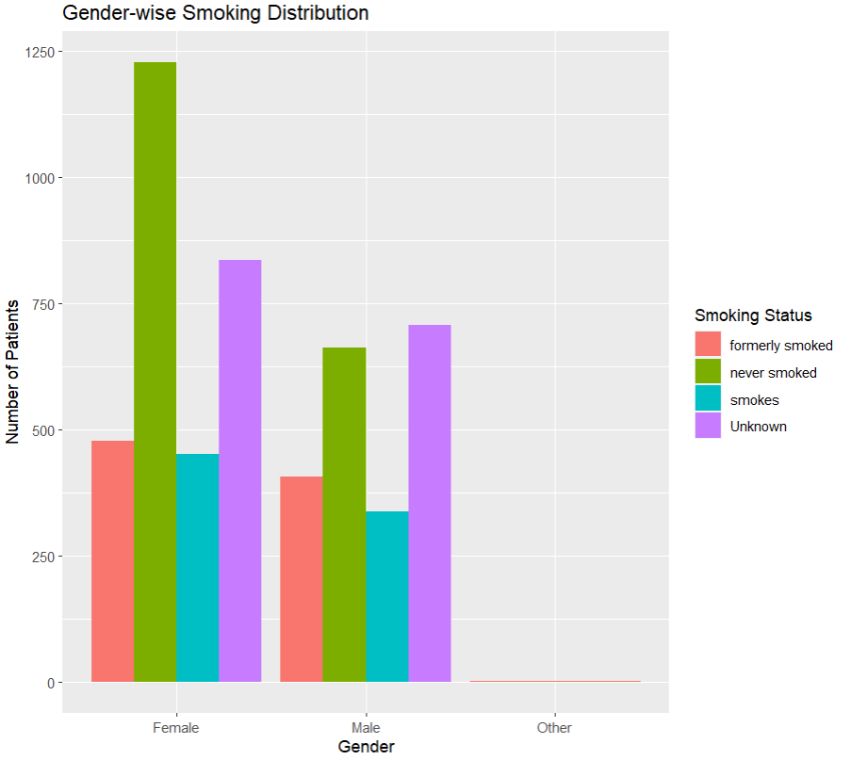
Smoking demographic

Slide 15
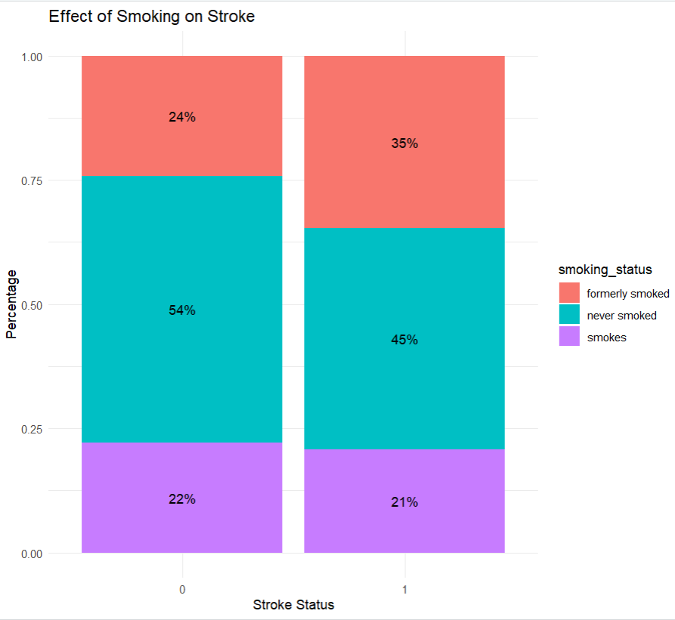
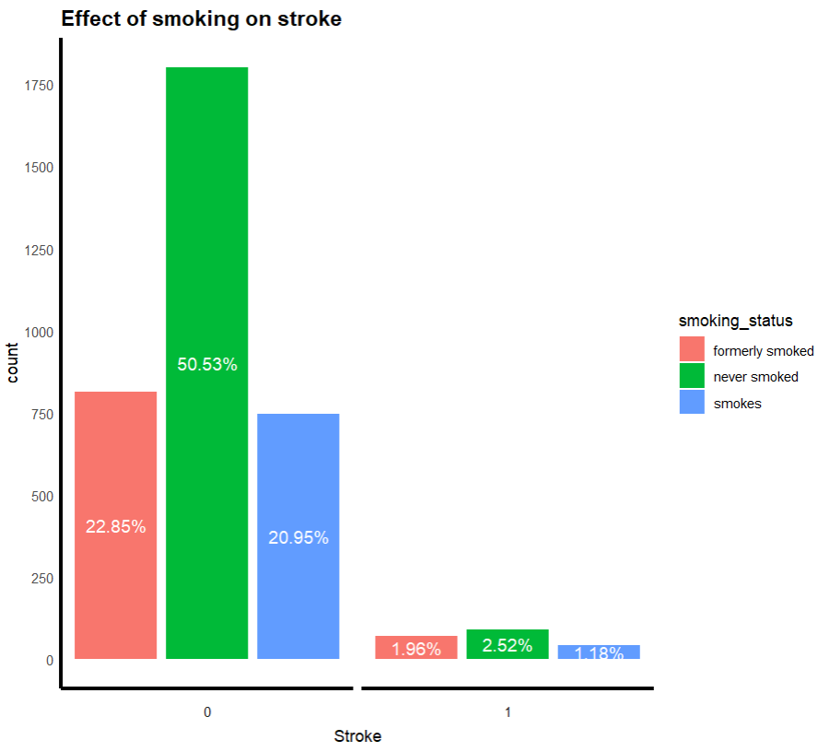
Smoking vs stroke

Slide 16
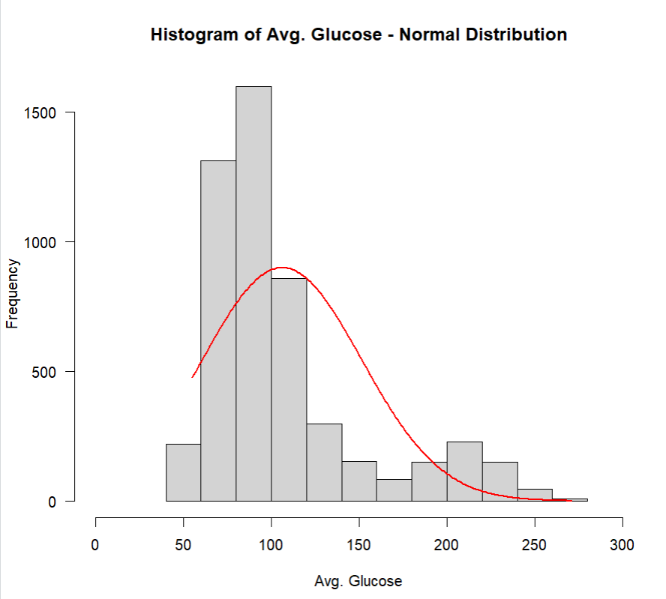
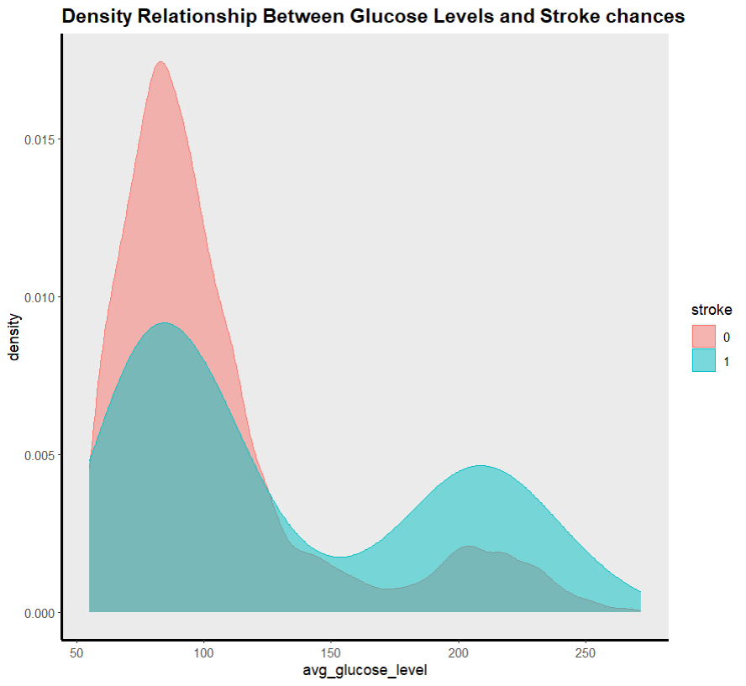
Glucose levels and Stroke status

Slide 17

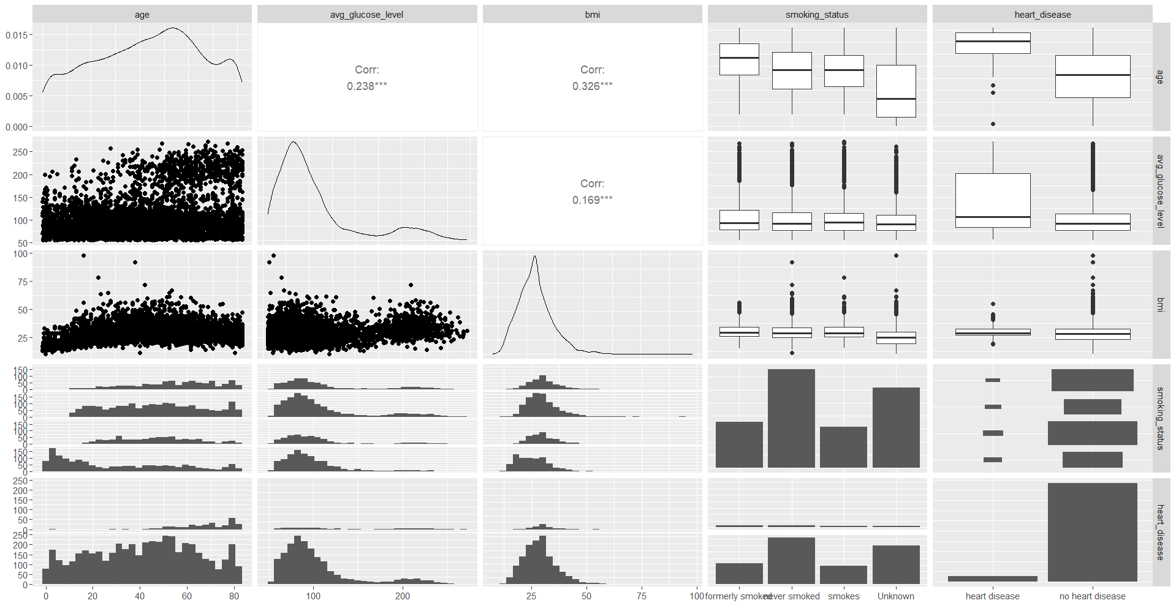
Correlation between top risk factors

Slide 18
Conclusion
Among the 5110 patients in the dataset, 249 suffered from strokes, while the remaining 4861 did not.
Elder people are more vulnerable to stroke than younger people.
The presence of heart disease, hypertension, and high blood sugar increases the risk of stroke.
People in the age group of 50-65 are at a higher risk of stroke if they have heart disease, and high blood sugar.
The impact of smoking on stroke risk is inconclusive and requires further investigation.
Age has a clear link with stroke risk.
BMI appears to have a negligible impact on stroke risk, although the percentage of overweight and obese patients is slightly higher among stroke patients.

